Slide 1
5 Question Zoom Quiz
PLEASE choose "I don't know" instead of guessing because guessing the right answers disrupts this process
The goal isn't to be right. We actually ignore correct answers and only focus on what people get wrong to know where to spend more time explaining.
Once the quiz reaches quorum we'll start.
Notes:
PLEASE choose "I don't know" instead of guessing because guessing the right answers disrupts this process
If you think you'll get the answers wrong please take the quiz. We actually ignore correct answers and only focus on what people get wrong.

Slide 2
Designing Data‑Intensive Systems – Chapter 2
Data Models & Query Languages
"Data models are perhaps the most important part of developing software, because they have such a profound effect: not only on how the software is written, but also on how we think about the problem that we are solving.”
Notes:
Welcome everyone. This thirty‑minute session distills Chapter 2 of **“Designing Data‑Intensive Applications”**.
We will trace the evolution from hierarchical and relational data models through today’s document and graph paradigms, and we will explore how query languages—from SQL to SPARQL—shape the way we think about data.
Whether you build APIs, architect storage layers, or optimise queries, understanding the trade‑offs behind each model will help you choose the right tool and avoid costly rewrites later.
I will first give a high‑level map of key concepts, then dive into each model with concrete diagrams and code samples lifted directly from the book.
By the end you should be able to:
• recognise when documents beat tables,
• spot impedance mismatches early,
• articulate why declarative languages improve performance,
• and explain how property graphs and triple‑stores unlock highly connected data.
Please jot down questions as we go—we will have time at the end. Let us begin.

Slide 3
Terms
SQL: relational, structured, schema-based.
NoSQL - Non-relational database systems.
Normalization: Reduce redundancy, split data.
Denormalization: Add redundancy, combine data.
ACID transactions—Atomic, Consistent, Isolated, Durable
OLTP - Online transaction processing

Slide 4
Chapter 2 Roadmap
Why data models matter – mental model → software architecture
Relational vs Document – tables, JSON & NoSQL drivers
Schema flexibility & locality – performance + evolution
Query paradigms – declarative, MapReduce, aggregation
Notes:
This slide orients the audience.
First, we will briefly revisit why choosing a data model is not merely a storage decision but a cognitive framework that influences every layer above it.
Next, we compare the long‑standing relational model with the increasingly common document model (SQL vs NoSQL), teasing out cases where JSON’s hierarchical representation shines.
That naturally leads to schema flexibility and the deep performance implication of locality—how bytes on disk map to objects in memory.
We then widen the lens to query paradigms: declarative SQL, functional MapReduce, and pipeline abstractions such as MongoDB’s aggregator.
Finally, we venture into graph territory, examining how property graphs and triple‑stores solve many‑to‑many relationships, and we sample three expressive languages: Cypher, SPARQL and Datalog.

Slide 5
Key Concepts – Definitions
Data model – formal structure + operations for data
Schema – explicit (on‑write) or implicit (on‑read)
Impedance mismatch – gap between in‑memory objects & stored rows
Locality – related bytes stored together for efficient I/O
Notes:
Before diving into specific models, we establish four foundational terms.
**Data model** is the explicit vocabulary that lets software agree on shape, constraints and operations. Think of it as the grammar of data.
A **schema** can be enforced when data is written—classical SQL—or interpreted lazily when read, common in document stores.
**Impedance mismatch** is a hardware analogy describing the friction when object‑oriented code must map to tables; ORMs help but never remove it entirely.
Finally, **locality** captures the performance edge we gain when bytes that are read together live next to each other on disk or in cache.
These four ideas will recur, so lock them in now.

Slide 6
Key Concepts – Why They Matter
Performance hinges on matching access patterns to storage layout
Maintainability improves when model matches developer mental model
Scalability & distribution depend on query flexibility, join cost
Evolvability – loose or strict schemas dictate migration effort
Notes:
Why spend half an hour on theory? Because the choice of model surfaces in every performance incident, every refactor and every scaling project.
When the layout on disk mirrors the application’s access pattern, caches warm quickly, and indexes are simple.
When tables collide with the developer’s mental model, code accrues hacks and duplication.
In distributed systems, the true cost of a join explodes—pushing some teams toward denormalisation, others toward graph stores.
Lastly, schemas that are either too rigid or too lax can turn a harmless feature request into a multi‑week migration.
With the stakes clarified, let’s explore the concrete models.

Slide 7
Relational Model – 50 Years Strong
Tables & rows model data as unordered sets (Codd, 1970)
ACID transactions underpin reliability for OLTP
SQL = declarative access; optimizer picks access path
Joins & normal forms tame duplication, enable many‑to‑many
Notes:
OLTP - Online transaction processing The relational model, conceived by Edgar F. Codd in 1970, treats every dataset as a set of tuples in relations—what we call rows in tables.
Because order is irrelevant, the optimizer is free to reorganise storage, build indexes and rewrite plans without breaking semantics.
ACID transactions—Atomic, Consistent, Isolated, Durable—make it the bedrock for banking, reservations and later web workloads.
Crucially, **joins** let one table reference another through foreign keys, eliminating duplication at the price of extra lookups. Normal forms 1 through 3 formalise when to split tables. (Deep dive doc will be sent out that walks through the "normal forms")
For three decades relational databases dominated because no competitor matched their mix of flexibility and safety.

Slide 8
Document Model – JSON & Friends
Self‑contained documents store nested data as trees
Schema‑on‑read : database is agnostic, code validates
Impedance solved? fewer joins, closer to object graphs
Popular engines – MongoDB, CouchDB, RethinkDB
Notes:
Document databases treat each record as a standalone JSON or BSON document. Nested arrays capture one‑to‑many relations inline, so the entire résumé or order ships in a single fetch.
With **schema‑on‑read** we trade compile‑time guarantees for agility—new fields can appear without DDL.
Developers often claim this closes the impedance mismatch: the in‑memory representation resembles what’s on disk.
That said, documents excel only when relationships rarely cross document boundaries, otherwise duplication or multi‑query gymnastics rear their head.
The model surged with the web 2.0 era through engines like MongoDB, CouchDB and RethinkDB.

Slide 9
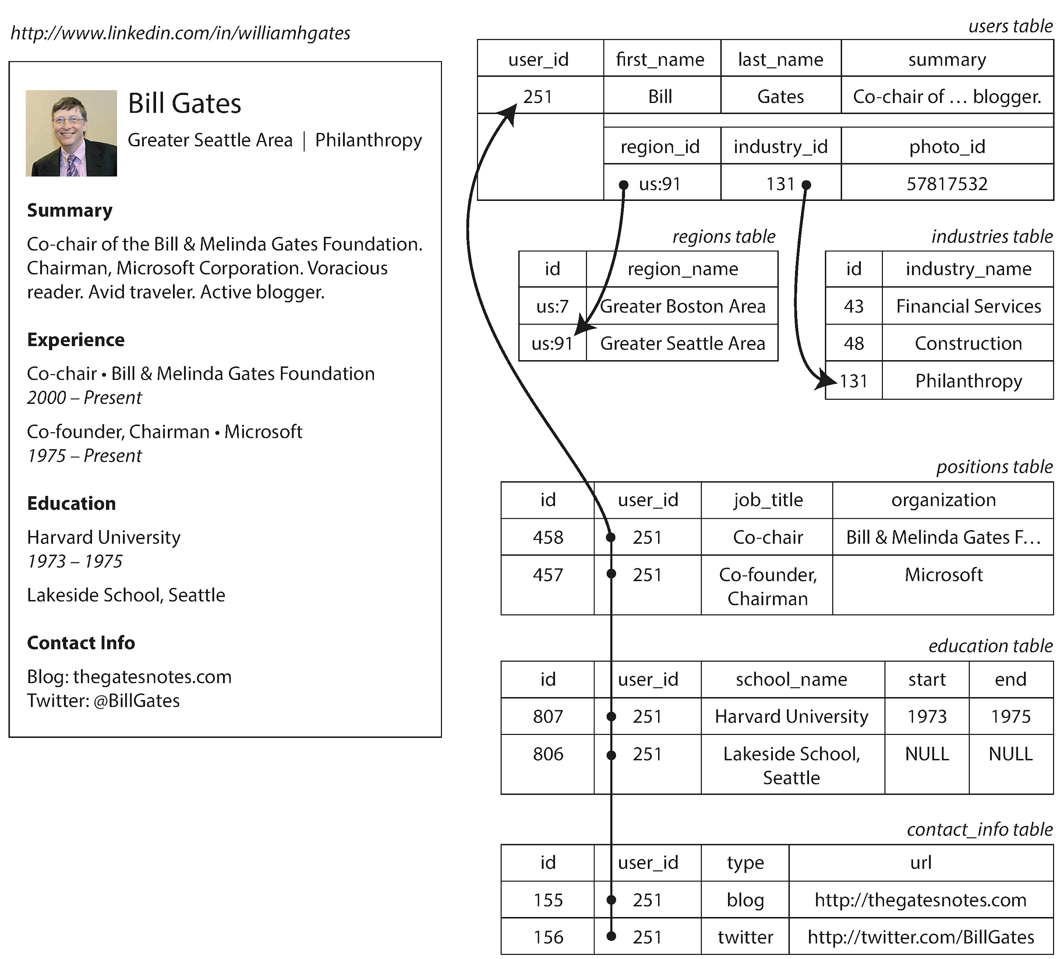
Figure 2‑1: Relational Résumé Schema
Traditional normalised design splits users, positions, education, contact_info
Fetching a profile needs multi‑table joins or N+1 queries
Notes:
Let's walk through an example using LinkedIn profiles
On the left you see the user interface sketch; on the right four tables.
Follow the arrows: the **users** table’s primary key *user_id = 251* fans out to **positions**, **education**, **contact_info**.
Each child table contains multiple rows per user, establishing one‑to‑many relationships.
While this structure is elegant on paper and prevents duplication, rendering a single profile triggers at least four joins or round‑trips (seperate queries).
In latency‑sensitive APIs it quickly becomes a bottleneck, motivating the document alternative we will see next.

Slide 10
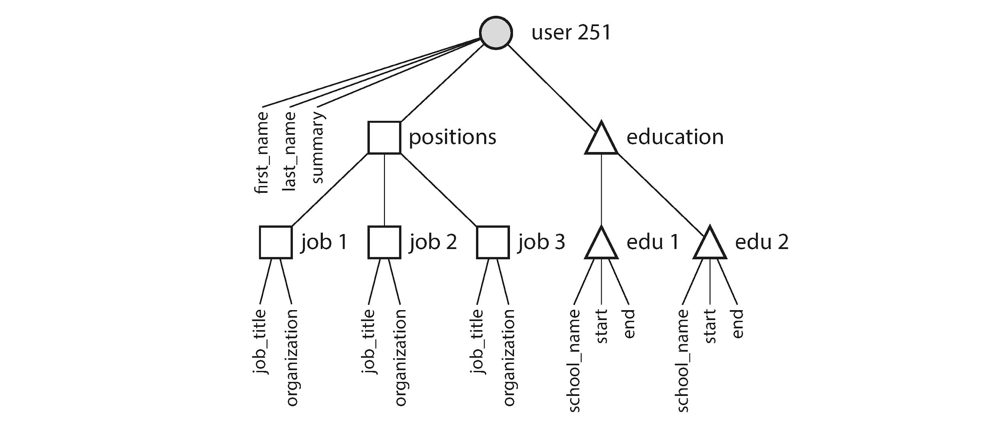
Figure 2‑2: Tree Structure in Documents
Document embeds positions, education, contact_info directly
One query returns the entire résumé; excellent locality --> findOne({user_id:251})`
Notes:
Focus on the root node labelled user 251.
Branches descend to embedded arrays: positions and education.
Because the JSON document mirrors this tree, a single `findOne({user_id:251})` returns everything.
Fields like —job_title, organization—travel with each array element, sacrificing some space to gain locality.
This tree only works for one‑to‑many edges; the moment two résumés reference the same organisation we face duplication or additional collections.

Slide 11
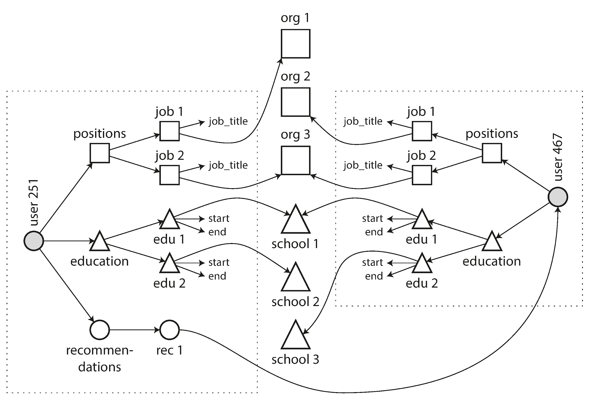
Many‑to‑Many Emerging (Fig 2‑4)
New features link people ↔ organisations ↔ schools
Document model struggles—needs references or duplication
Notes:
As LinkedIn adds company pages, school pages and peer recommendations, the data morphs from a neat tree into a graph.
Every extra line is a join the document database cannot execute natively; developers must choose between client‑side joins or denormalising.
Neither is free: the former hurts latency, the latter complicates consistency.
This visual sets the stage for graph databases later in the talk.

Slide 12
Data Locality & Performance
Grouping related fields cuts seeks & boosts cache hits
Updates rewrite whole document; large docs become costly
Relational & Bigtable families offer interleaved or clustered rows
Notes:
Re‑use the tree diagram to emphasise locality.
When the application routinely needs the full subtree—say to render a LinkedIn profile—storing it contiguously is a big win: fewer disk seeks, predictable I/O.
But locality is a double‑edged sword: any update that grows the document forces a rewrite, making write amplification proportional to document size.

Slide 13
NoSQL & Polyglot Persistence
Scalability – sharding & eventual consistency beyond a single machine
Open source ethos drove adoption (2009 #NoSQL meetup)
Specialised queries – text, time‑series, column families
Polyglot: choose per‑feature, not one‑ring‑to‑rule‑all
Notes:
Coined at a casual meetup, the term **NoSQL** caught on because it bundled several dissatisfactions: rigid schemas, licence costs, and single‑node ceilings.
Modern architectures increasingly embrace **polyglot persistence**—it is normal for the same product to keep payments in Postgres, events in Kafka, search in Elasticsearch and graphs in Neo4j.
This mindset reframes the question from *Which database is best?* to *Which database is best for this access pattern?*

Slide 14
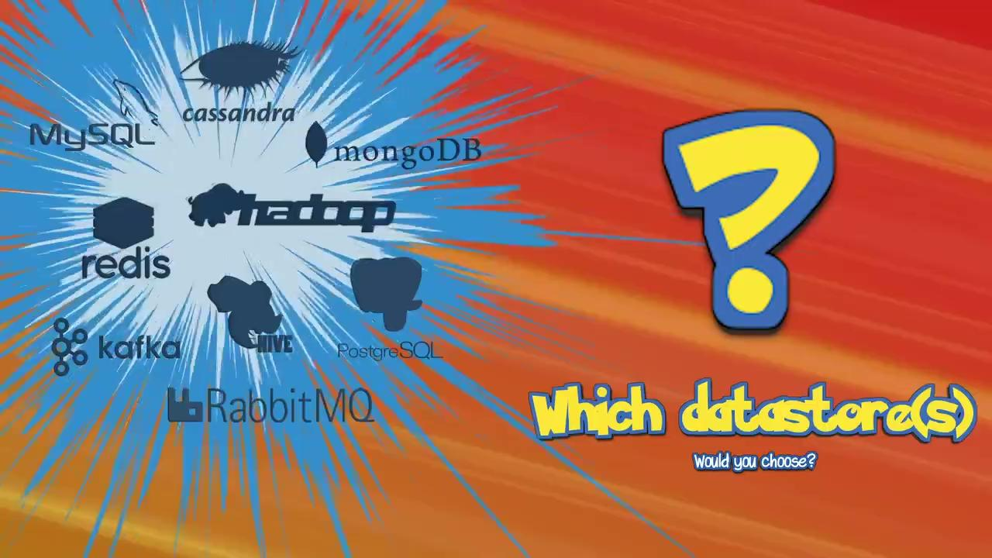
Notes:
Lets have an open discussion about this system design challenge which relies on polyglot persistence. In the next slide I’ll present a scenario and I want people from the audience to tell me which data stores will be a good fit. You are not limited to the options here. The only requirement is to explain why you choose which option.

Slide 15
Realtime Pokemon System Design
Scenario: You’re working on an api for a new realtime online Pokemon game. Your focus is the battle engine. The battle engine keeps track of which group of Pokemon each player selected for a battle, their current hit points (HP), combat power (CP) and each player’s turn.
During every turn, when a player makes a move the battle engine needs access to this state to perform certain tasks such as decrease the hit points of an attacked Pokemon, present a list of Pokemon who can still battle, control which player is allowed to attack this turn…etc
Requirements
The game is projected to have 1 million users in the first month and grow by 300% in the first 6 months.
Every day for 4 hours there is a peak load of 100,000 users actively battling each other at the same time leading to the following expected load:
4k writes per second
64k reads per second
Which datastore(s) would you chose to store and read the game state during a battle and why?
Notes:
Don’t read these notes out loud:
Any solution that addresses the high writes and reads appropriately is good
Also needs to address how to recover from crashes to prevent data loss
How to score quickly
• Green flag answer:
“I’d keep the battle state in Redis Cluster for sub-ms ops; every mutation is also written asynchronously to Kafka, then persisted into DynamoDB/S3 for recovery and analytics.”
• Yellow flag:
Mentions Cassandra or MongoDB in place of Redis but still combines with cache/event log.
• Red flag:
Relies solely on Postgres/MySQL for live play, or confuses queue with datastore.
⸻
One-liner the stand-in can use
“Remember, we need both a lightning-fast in-memory store for the current battle and a durable log for replay or audit. If your design covers those and avoids hot partitions, you’re on the right track!”

Slide 16
Schema Flexibility & Migration
Schema‑on‑write (SQL) ⇒ ALTER TABLE, index rebuilds
Schema‑on‑read (JSON) ⇒ versioning in code paths
Hybrid: relational tables + JSON columns (Postgres 9.3, MySQL 5.7)

Slide 17
Feature Request
Split Full names into First and Last name.
Notes:
Lets contrast two versions of the same feature request: split full names into first and last.

Slide 18
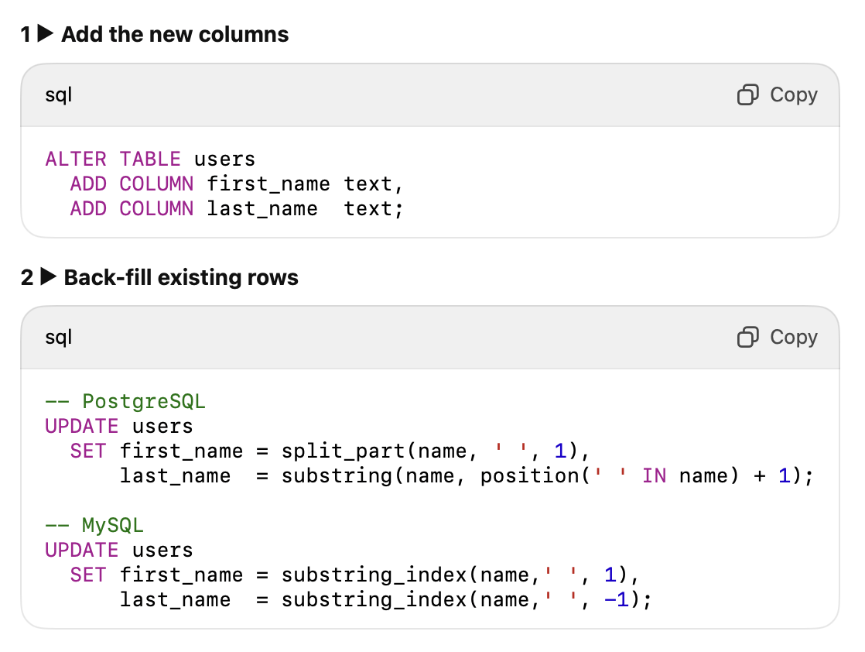
Relational-Database (Schema Migration) Style
Notes:
In SQL the change is explicit—`ALTER TABLE users ADD COLUMN first_name text;` possibly followed by an `UPDATE`.
Contrary to folklore, most engines apply these types of migrations in milliseconds, though MySQL’s historical table‑copy penalty spawned tools like pt‑online‑schema‑change.

Slide 19
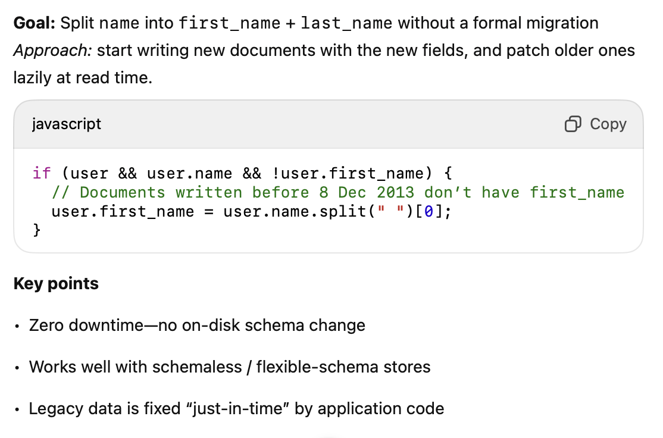
Document-Database Approach
Notes:
In a schemaless store you simply start writing new documents; legacy readers detect the absence of *first_name* and derive it.
Both strategies cost engineering time, just at different stages; what looks agile today can incur subtle complexity tomorrow.
Many teams now embed unstructured JSON inside relational tables to mix guarantees with flexibility.

Slide 20
Hybrid
Add new attributes without ripple-effects across dozens of services or a costly schema migration.
Keep the strong guarantees of a relational model (keys, transactions, joins) while adding a “schemaless lane” for opt-in fields.

Slide 21
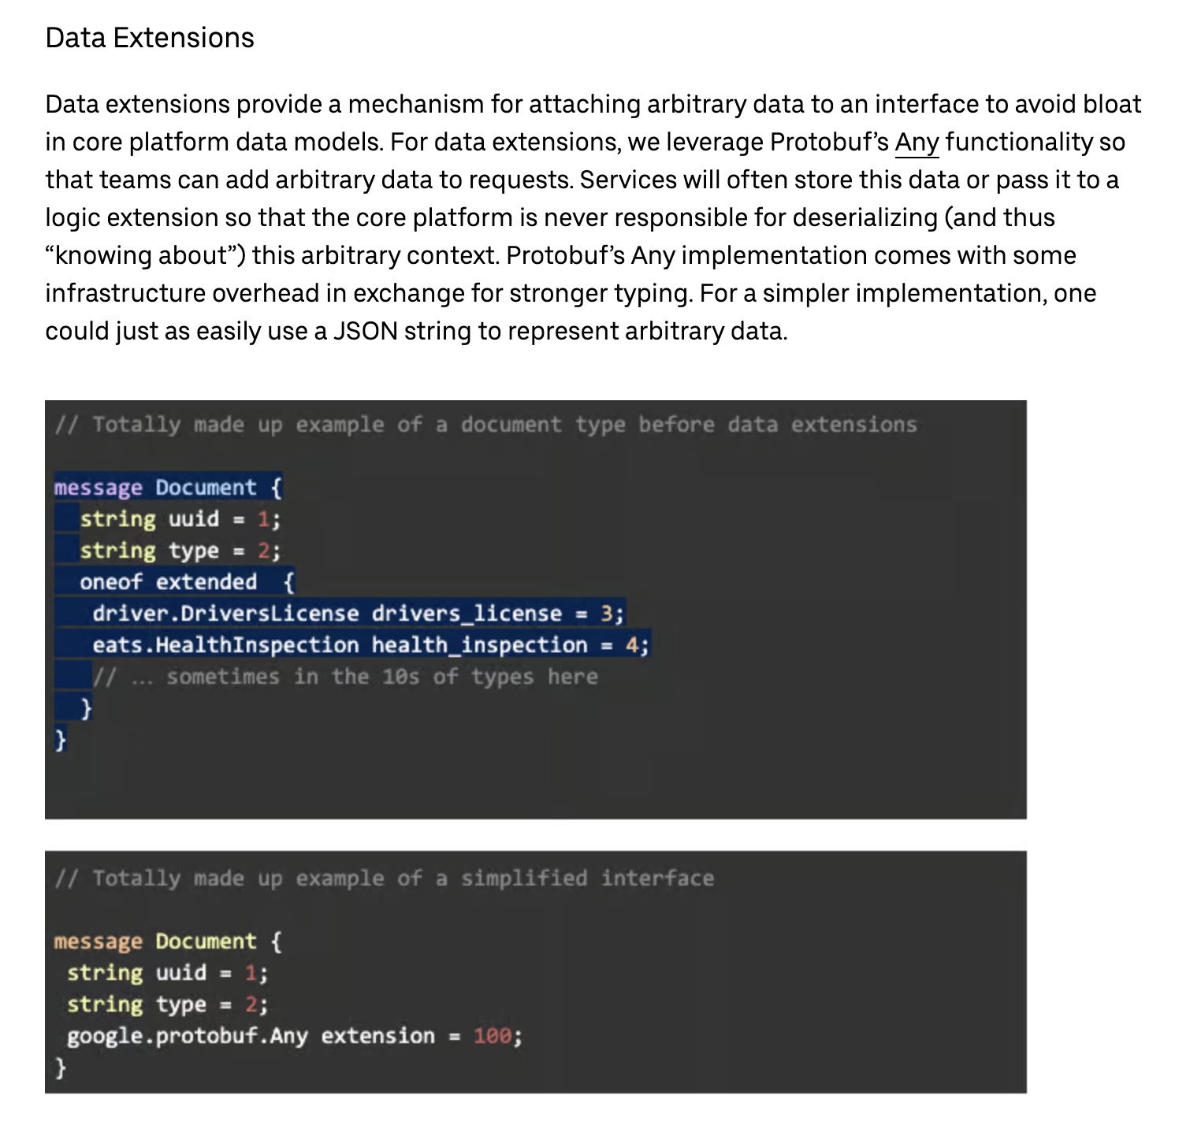
Approach: Data Extensions
https://www.uber.com/en-GB/blog/microservice-architecture/
Notes:
This is useful in large scale distributed systems where data flows through many microservices before reaching the destination where it will be used
It avoid needing to modify all services within that read path

Slide 22
Declarative vs Imperative Queries
Declarative: state the *what* (SQL, Cypher, SPARQL)
Imperative: spell out the *how* (COBOL, MapReduce API)
Optimiser freedom ⇒ parallelism & automatic indexes
Notes:
Use the classic animal filtering example:
Imperative JavaScript loops over `animals[]` comparing each family. Declarative SQL simply says `SELECT * FROM animals WHERE family = 'Sharks';`
The latter is shorter **and** allows the engine to pick an index, push predicates, or parallelise execution without changing code.
This separation of concern is why declarative languages have aged so well and why even MapReduce jobs are now wrapped in higher‑level DSLs.

Slide 23
MapReduce & Aggregation Pipeline
Map (`emit`) & Reduce (`sum`) functions over huge datasets
Example: count sharks per month across observations
MongoDB 2.2 introduced aggregation pipeline – declarative stages
Notes:
Walk through the JavaScript shown in the book: the map extracts *year‑month* and emits `numAnimals`; the reduce sums the array of counts.
Stress purity constraints: no side effects, no secondary queries.
Then contrast with Mongo’s newer pipeline—`$match`, `$group`, `$sum`—which is closer to SQL and easier for the optimiser to rearrange.
Point out that Hadoop‑era MapReduce popularised horizontal scalability but has since been largely abstracted away by Spark, Presto and Beam.

Slide 24
Summary & Takeaways
Tables excel at joins & integrity; beware impedance
Documents win on locality & agility; watch duplication
Declarative languages let optimizers evolve independently
Notes:
Wrap up the narrative:
Relational, document and graph models are complementary, not replacements.
Evaluate by query shape, update patterns, team skill and ecosystem maturity.
Use declarative languages wherever possible—they future‑proof your code by isolating you from physical storage decisions.

Slide 25
Questions & Discussion
Where have you hit impedance mismatch pain?
What part of your stack could benefit from a different model?
Notes:
Thank the audience and open the floor.
Good prompts include asking who has performed a painful schema migration or who has denormalised for performance.
Encourage experience sharing—stories anchor these abstract ideas.

